Slide 1
Customer Lifetime Value

Slide 2
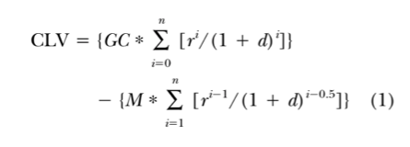
Model 1

Slide 3

Model 2a

Slide 4

Model 2b

Slide 5
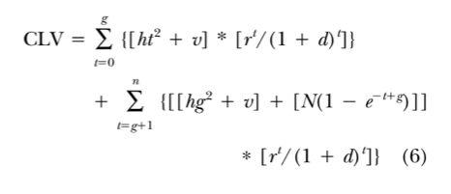
Model 3

Slide 6
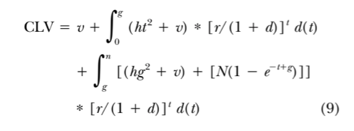
Model 4

Slide 7
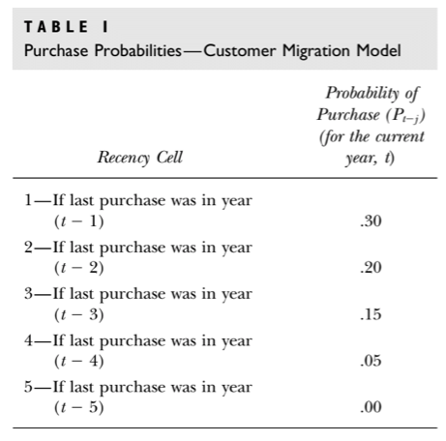
Migration Model

Slide 8
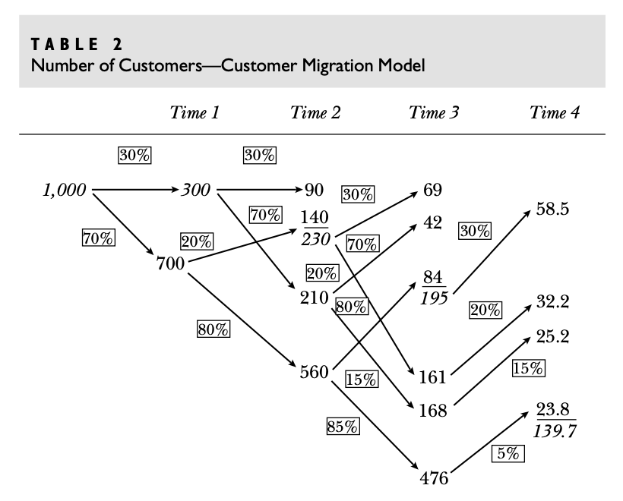

Slide 9
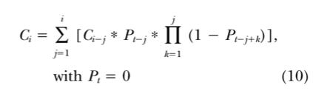
Migration Model

